Slide 1
Error & Exception Handling in C#
October 21, 2016

Slide 2
Agenda
What is Exception?
throw statement
Exception class
Application Exception
Handling Exception
Catch block
Finally block

Slide 3
Exceptions in C#
Must inherit from System.Exception
Standard error handling in C#
Are thrown when:
the code reaches a throw statement
System exceptions occur (such as divide by zero)
No checked exceptions or exception specifications

Slide 4
throw statement
Must throw an instance of an exception:
throw(new MyException(“Error”));
May be used by itself only in a catch block:
catch
{
throw;
}

Slide 5
Creating an Exception Class
Inherits from System.Exception or a derived class
public class Exception1 : System.Exception {
public Exception1(string message) : base(message){}
}
public class SomeException : Exception1 {
public SomeException(string message) : base(message){} }

Slide 6
ApplicationException
Exceptions defined within an application should extend (inherit from) System.ApplicationException

Slide 7
Catching an Exception
A catch block is associated with a try block
A try block may have more than one catch block
catch blocks catch the exception type or any derived exception types passing through
catch blocks are searched in the order they appear in the code
catch blocks for specific types must come before the more general types
An Empty catch clause will catch any type
catch clauses don’t need a variable name
catch(Exception) is ok

Slide 8
catch blocks
Wrong
Right
void function1() {
try
{
// code
}
catch(Exception ex)
{
}
catch(Exception1 ex)
{ }
}
void function1() {
try
{
// code
}
catch(Exception1 ex)
{
}
catch(Exception ex)
{ }
// if no rethrow occurs
// execution resumes here
}

Slide 9
Exception Flow Control
The exception is passed up until a suitable handler is found
void function1() {
try
{
try
{
throw(new SomeOtherException(“Error Message”));
}
catch(Exception1 ex)
{
}
}
catch(Exception2 ex)
{ }
}

Slide 10
Exception Flow Control
If no suitable handler (catch clause) was found, the exception is passed to the calling method
void function2() {
try
{
Function1();
}
catch(Exception3 ex3)
{
}
catch(Exception2 ex4)
{ }
catch(Exception ex)
{ }
}

Slide 11
Unhandled Exceptions
If no error handler is found the application terminates
Control is passed back to Windows

Slide 12
finally block
Must be associated with a try block
a try block may have only one finally block
finally block always gets executed
The appropriate catch clause is executed first
Demo

Slide 13
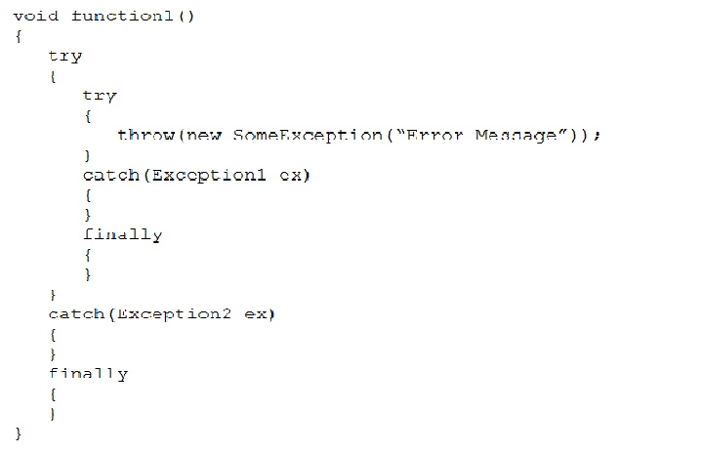
finally Flow Control

Slide 14
Some Special Rules
Unhandled Exception in a destructor
destructor stops executing, exception is discarded, base destructor is called
catch (with no parameter) will catch unmanaged exceptions from other languages

Slide 15
Library Exceptions
Feel free to use these:
ArithmeticException
ArrayTypeMismatchException
DivideByZeroException
IndexOutOfRangeException
InvalidCastException
NullReferenceException
OutOfMemoryException
OverflowException
StackOverflowException
TypeInitializationException

Slide 16
System.Exception Class
Message
string message associated with the exception
InnerException
If this exception was generated inside an exception handler, this refers to the original exception
Source
Refers to the source class
StackTrace
String representing the call stack, file and line number

Slide 17
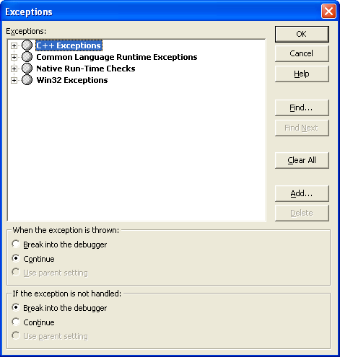
Breaking On Exceptions
Debug | Exceptions (or Ctrl + Alt + E)

Slide 18
Design Considerations
Class discussion

Slide 19

Thank You!
Prashant Kulkarni
Technical Lead
Mobile: +91 9890913122
Desk: +91 20 66046341
Prashant.kulkarni@xoriant.com
www.xoriant.com
India
Mumbai
4th Floor, Nomura
Powai , Mumbai 400 076
Pune
5th Floor, Amar Paradigm
Baner, Pune 411 045
Kolkata
2B, 12th Floor, Tower ‘C’
Rajarhat, Kolkata 700 156
US – Corporate Headquarters
1248 Reamwood Avenue,
Sunnyvale, CA 94089
Phone: (408) 743 4400
343 Thornall St 720
Edison, NJ 08837
Phone: (732) 395 6900
UK
20 Broadwick Street
Soho, London
W1F 8HT, UK
89 Worship Street
Shoreditch,
London EC2A 2BF, UK
Phone: (44) 2079 938 955
Bangalore
4th Floor, Kabra Excelsior,
80 Feet Main Road, Koramangala 1st Block,
Bengaluru (Bangalore) 560034
Gurgaon
A/373rd Floor, Sigma Center
Gurgaon, Haryana 122 011s

